Slide 1
LED DISPLAY

Slide 2
~200MM
~200MM

Slide 3
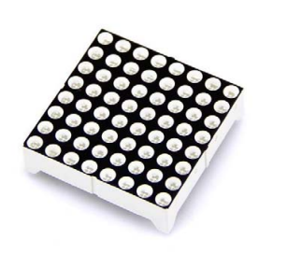
38MM
38MM

Slide 4
~228mm
~228mm

Slide 5
Considering space between panels
230mm
230mm

Slide 6
Unfortunately this one was obsolete
38MM
38MM

Slide 7
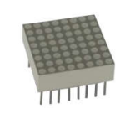
So we went with this one instead
20mm
20mm

Slide 8
~200mm
~200mm

Slide 9
Each led array is 1.20 which means it would be 120 bucks just for this simple desk display which I could probably buy from temu for less than 20.
Maybe I can make my own led array for less than 1.20?
If I can make a 20x20mm array with 8x8 leds for less than 0.20 each for materials then that would be worth while.
Maybe make a 32x32 led screen using these leds
https://www.digikey.com.au/en/products/detail/xinglight/XL-B1010RGBT-HF/25673321

Slide 10
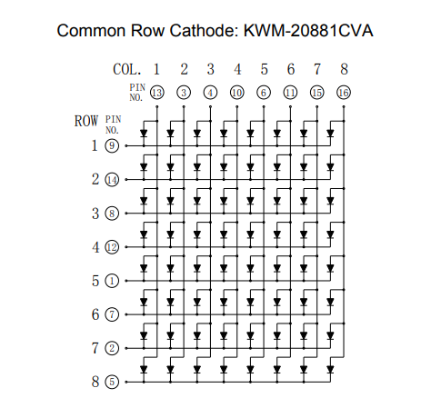
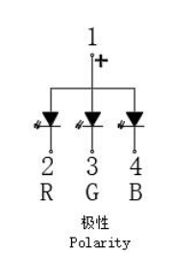
https://www.rxelectronics.com.ua/datasheet/64/kwm-20881ava.pdf
https://mm.digikey.com/Volume0/opasdata/d220001/medias/docus/8903/XL-B1010RGBT-HF.pdf

Slide 11
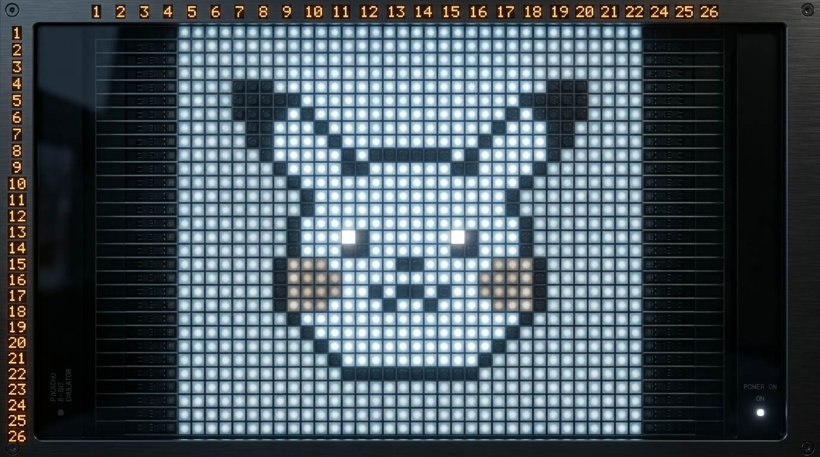
Could make it 22x22 still white only but cheaper.
$60 for 500 https://www.digikey.com.au/en/products/detail/lumimax-optoelectronic-technology/LED10WHI/29263557
Sqrt(500)=22
$120 for better resolution
$210 for rgb and better resolution
but only 13cm

Slide 12
I decided to make a 16x16 pixel screen using 256 of these lights for $35
https://www.digikey.com.au/en/products/detail/lumimax-optoelectronic-technology/LED10WHI/29263557

